Slide 1
Local search algorithms
AIMA Chapter 4

Slide 2
Outline
Hill-climbing
Simulated annealing
Genetic algorithms

Slide 3
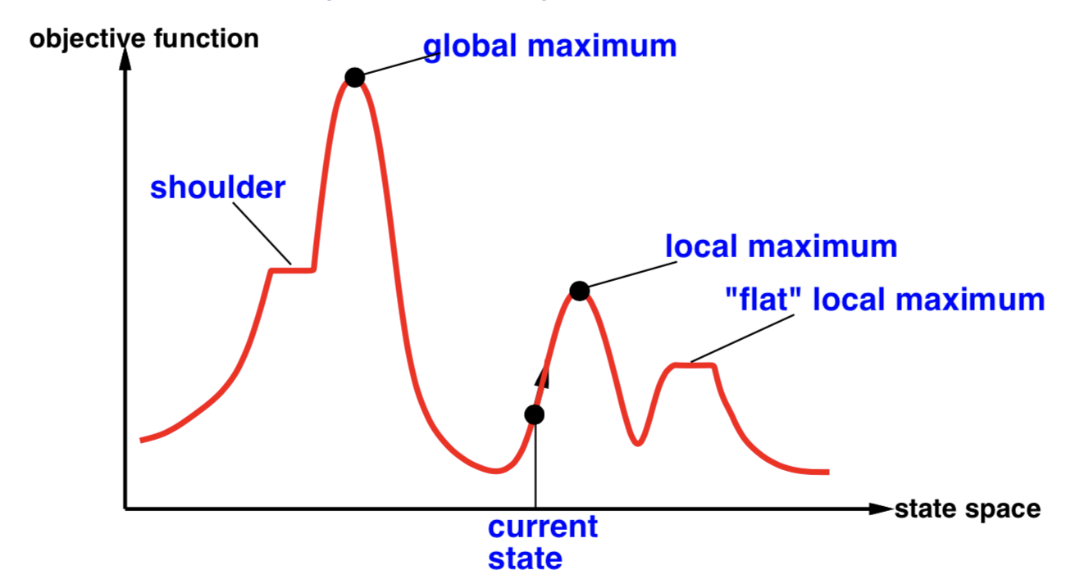
Hill-climbing (or gradient ascent/descent)
Random-restart hill climbing overcomes local maxima—trivially complete

Slide 4
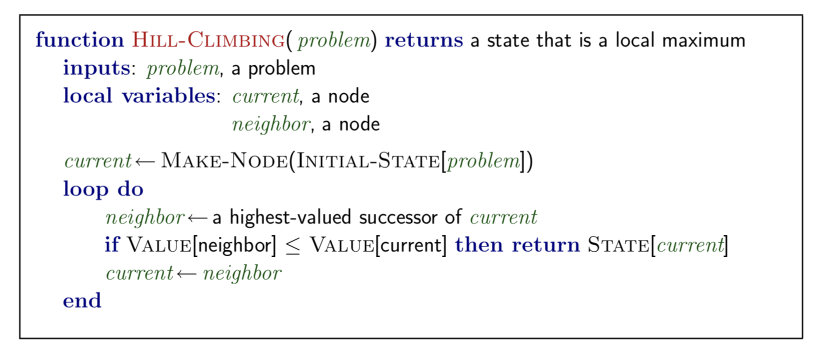
Hill-climbing (or gradient ascent/descent)

Slide 5
Hill-climbing: drawbacks
Local Maxima: peaks that aren’t the highest point in the space
Plateaus: the space has a broad flat region that gives the search algorithm no direction (random walk)

Slide 6
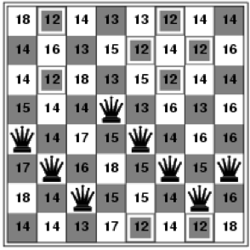
Hill-climbing for 8-queens problem
Objective function = number of pairs of queens that are attacking each other, either directly or indirectly
h = 17 for this state

Slide 7
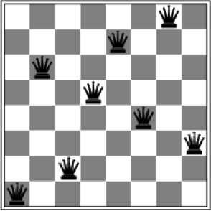
Hill-climbing for 8-queens problem
A local minimum with h = 1

Slide 8
Simulated Annealing (Kirkpatrick, 1983)
뜨거운 욕조에서 재료의 냉각을 시뮬레이션하는 알고리즘에 기반
Local(neighborhood) search
확률론적 메타휴리스틱 방법
Idea: Escape local maxima by allowing some “bad” moves but gradually decrease their size and frequency
Annealing
내부 강도를 제거하기 위해 금속이나 유리를 가열하고 천천히 냉각시키는 방법
금속재료를 가열한 다음 조금씩 냉각해 결정을 성장시켜 그 결함을 줄이는 작업
열에 의해서 원자는 초기의 위치(내부 에너지가 극소점에 머무르는 상태)로부터 멀어져 에너지가 더욱 높은 상태로 추이됨
천천히 냉각함으로써 원자는 초기 상태보다 내부 에너지가 한층 더 극소인 상태를 얻을 가능성이 많아짐

Slide 9
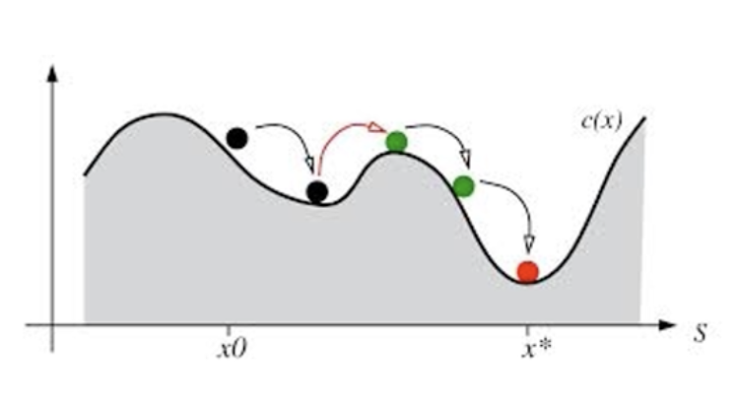
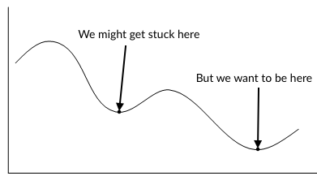
SA Algorithm
1) 초기해를 만든다 2) 현재의 해를 랜덤하게 변화 3) 새로운 해가 원래의 해보다 더 좋다면 바꾸고
4) 새로운 해가 원래의 해보다 조금 나쁘고 (delta) 랜덤하게 생성한 0-1 사이의 수가 acceptance probability보다 적으면 나쁜 해로 바꾼다. 처음에는 나쁜 해로의 이동을 높은 확률로 허가하고, 점차 낮춘다 ( difference/temprature). 5) 2~4의 과정을 반복
If T decreases slowly enough, then simulated annealing search will find a global optimum with probability approaching 1
출처:http://blog.pluszero.ca/blog/2016/07/17/using-simulated-annealing-to-solve-logic-puzzles/

Slide 10
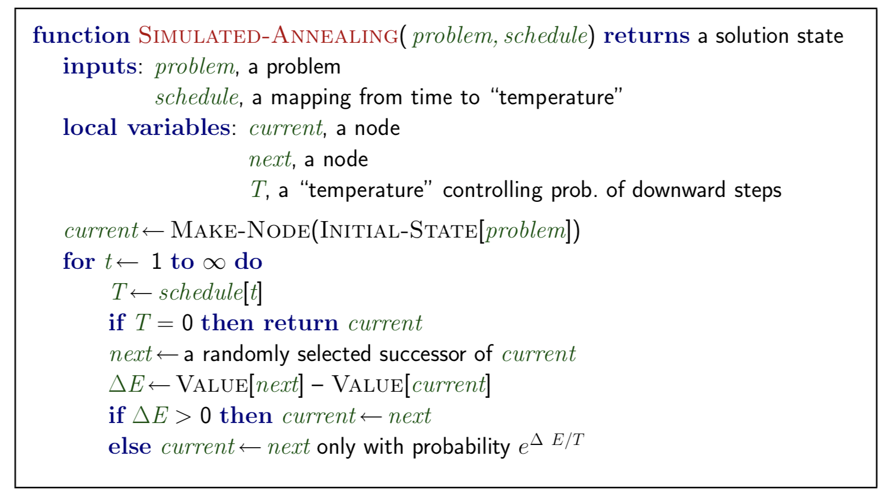
SA Algorithm
#반복될수록 T 값이 작아지고 나쁜해가 선택될 확률이 낮아짐
#최소값을 찾는 경우. 𝛥E = value[current] - value[next]

Slide 11
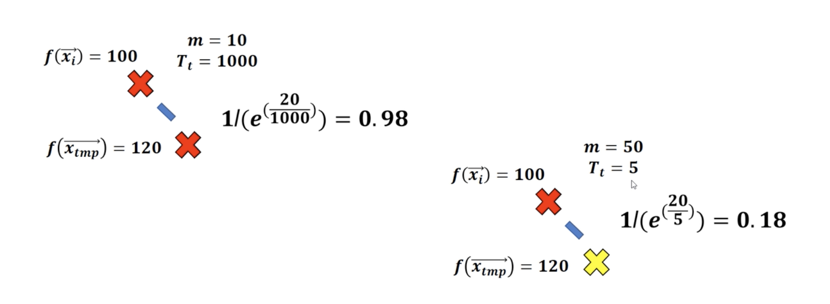
Simulated Annealing
반복될수록 T 값이 작아지고 나쁜해가 선택될 확률이 낮아짐
이 예제는 최소값을 찾는 경우. 𝛥E = value[current] - value[next]

Slide 12
Word Segmentation Example
Annotate each character with a boolean value to indicate whether or not a word-break appears after the character
Segmentation becomes a search problem: find the bit string that causes the text string to be correctly segmented into words
>>> text = "doyouseethekittyseethedoggydoyoulikethekittylikethedoggy" >>> seg1 = "0000000000000001000000000010000000000000000100000000000" >>> seg2 = "0100100100100001001001000010100100010010000100010010000" >>> segment(text, seg1) ['doyouseethekitty', 'seethedoggy', 'doyoulikethekitty', 'likethedoggy'] >>> segment(text, seg2) ['do', 'you', 'see', 'the', 'kitty', 'see', 'the', 'doggy', 'do', 'you', 'like', 'the', 'kitty', 'like', 'the', 'doggy']
https://www.nltk.org/book/ch03.html

Slide 13
Word Segmentation Example
Annotate each character with a boolean value to indicate whether or not a word-break appears after the character
Segmentation becomes a search problem: find the bit string that causes the text string to be correctly segmented into words
def segment(text, segs): words = [] last = 0 for i in range(len(segs)): if segs[i] == '1': words.append(text[last:i+1]) last = i+1 words.append(text[last:]) return words
>>> text = "doyouseethekittyseethedoggydoyoulikethekittylikethedoggy" >>> seg1 = "0000000000000001000000000010000000000000000100000000000" >>> seg2 = "0100100100100001001001000010100100010010000100010010000" >>> segment(text, seg1) ['doyouseethekitty', 'seethedoggy', 'doyoulikethekitty', 'likethedoggy'] >>> segment(text, seg2) ['do', 'you', 'see', 'the', 'kitty', 'see', 'the', 'doggy', 'do', 'you', 'like', 'the', 'kitty', 'like', 'the', 'doggy']

Slide 14
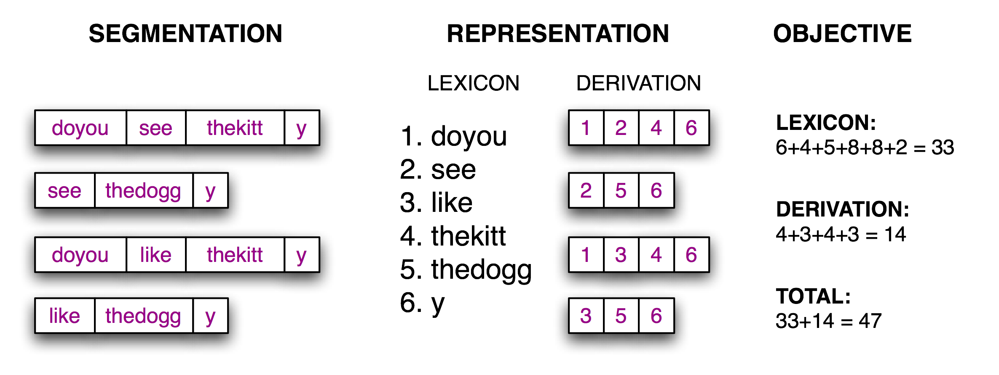
Objective function
Given a suitable lexicon, reconstruct the source text as a sequence of lexical items
Objective function, a scoring function whose value we will try to optimize, based on the size of the lexicon (number of characters in the words plus an extra delimiter character to mark the end of each word) and the amount of information needed to reconstruct the source text from the lexicon

Slide 15
Objective function
search for the pattern of zeros and ones that minimizes this objective function
def evaluate(text, segs): words = segment(text, segs) text_size = len(words) lexicon_size = sum(len(word) + 1 for word in set(words)) return text_size + lexicon_size >>> text = "doyouseethekittyseethedoggydoyoulikethekittylikethedoggy" >>> seg1 = "0000000000000001000000000010000000000000000100000000000" >>> seg3 = "0000100100000011001000000110000100010000001100010000001" >>> segment(text, seg3) ['doyou', 'see', 'thekitt', 'y', 'see', 'thedogg', 'y', 'doyou', 'like', 'thekitt', 'y', 'like', 'thedogg', 'y'] >>> evaluate(text, seg3) 47 >>> evaluate(text, seg1) 64

Slide 16
Code
def flip(segs, pos): # pos의 값을 반전 return segs[:pos] + str(1-int(segs[pos])) + segs[pos+1:] def flip_n(segs, n): #n개의 포인트를 랜덤하게 반전 for i in range(n): segs = flip(segs, randint(0, len(segs)-1)) return segs def anneal(text, segs, iterations, cooling_rate): temperature = float(len(segs)) while temperature > 0.5: best_segs, best = segs, evaluate(text, segs) for i in range(iterations): guess = flip_n(segs, round(temperature)) score = evaluate(text, guess) if score < best: best, best_segs = score, guess score, segs = best, best_segs temperature = temperature / cooling_rate print(evaluate(text, segs), segment(text, segs)) print() return segs
Result
>>> text = "doyouseethekittyseethedoggydoyoulikethekittylikethedoggy" >>> seg1 = "0000000000000001000000000010000000000000000100000000000" >>> anneal(text, seg1, 5000, 1.2) 61 ['doyouseetheki', 'tty', 'see', 'thedoggy', 'doyouliketh', 'ekittylike', 'thedoggy'] 59 ['doy', 'ouseetheki', 'ttysee', 'thedoggy', 'doy', 'o', 'ulikethekittylike', 'thedoggy'] 57 ['doyou', 'seetheki', 'ttysee', 'thedoggy', 'doyou', 'liketh', 'ekittylike', 'thedoggy'] 55 ['doyou', 'seethekit', 'tysee', 'thedoggy', 'doyou', 'likethekittylike', 'thedoggy'] 54 ['doyou', 'seethekit', 'tysee', 'thedoggy', 'doyou', 'like', 'thekitty', 'like', 'thedoggy'] 52 ['doyou', 'seethekittysee', 'thedoggy', 'doyou', 'like', 'thekitty', 'like', 'thedoggy'] 43 ['doyou', 'see', 'thekitty', 'see', 'thedoggy', 'doyou', 'like', 'thekitty', 'like', 'thedoggy'] '0000100100000001001000000010000100010000000100010000000'

Slide 17
Local beam search
Idea: keep k states instead of 1; choose top k of all their successors
Searches that find good states recruit other searches to join them
Problem: quite often, all k states end up on same local hill
Idea: choose k successors randomly, biased towards good ones
Observe the close analogy to natural selection!

Slide 18
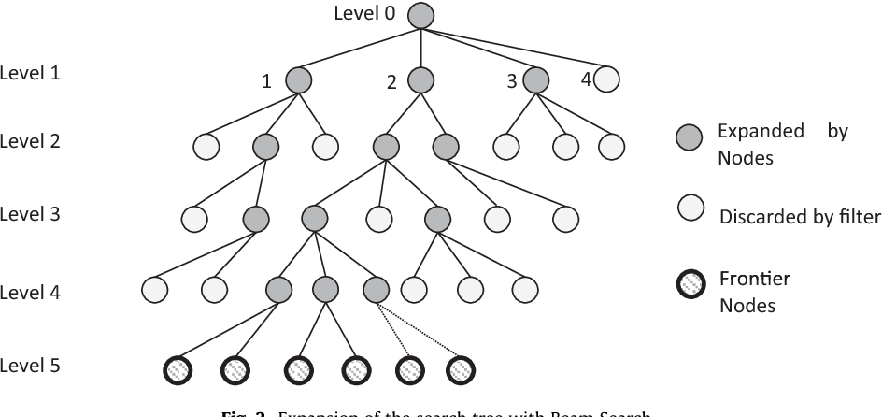
Local beam search
https://www.semanticscholar.org/paper/A-new-Hybrid-Filtered-Beam-Search-algorithm-for-of-Mej%C3%ADa-Ni%C3%B1o/2a27cdfa0e344aecbacb4f13439fb46f2c581584

Slide 19
Genetic Algorithms
For optimization and search problems
Start with k randomly generated states (population)
A state is represented as a string over a finite alphabet (often a string of 0s and 1s)
Evaluation function (fitness function). Higher values for better states
A successor state is generated by combining two parent states
Notes:
= stochastic local beam search + generate successors from pairs of states

Slide 20
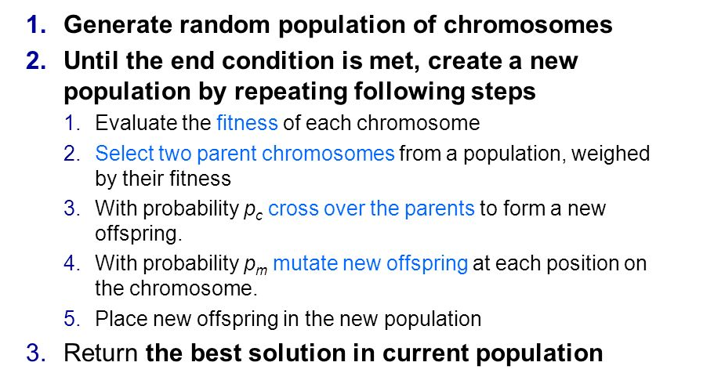
Genetic Algorithms
For optimization and search problems
Notes:
= stochastic local beam search + generate successors from pairs of states

Slide 21
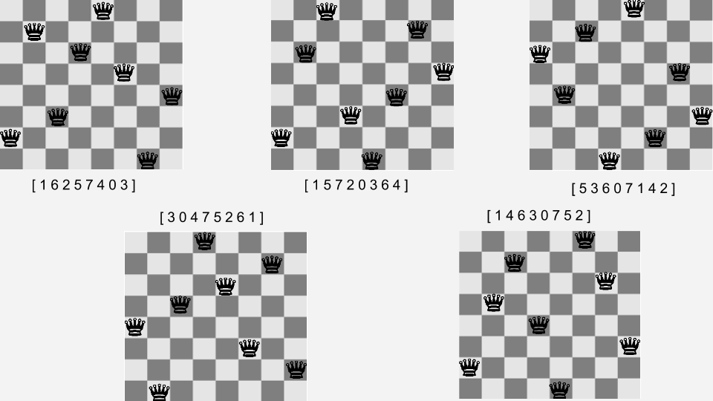
8-queen problem

Slide 22
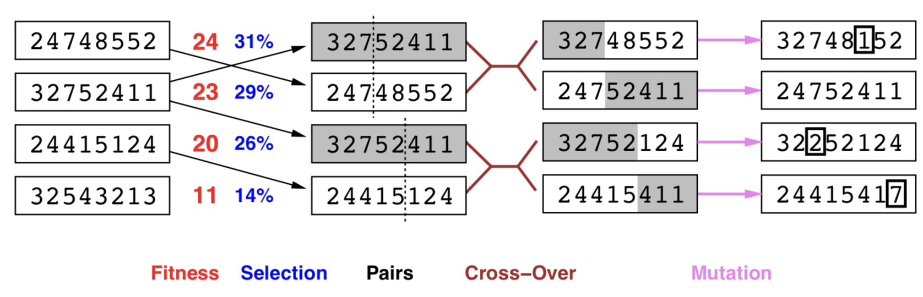
Genetic Algorithms for 8-queen problem
Fitness function: # of non-attacking pairs of queens (min = 0, max = 8 × 7/2 = 28)
24/(24+23+20+11) = 31%
23/(24+23+20+11) = 29%
etc

Slide 23
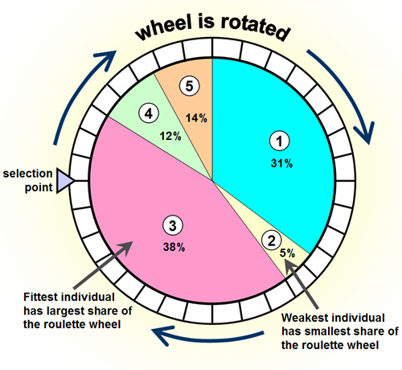
Roulette wheel
selection

Slide 24
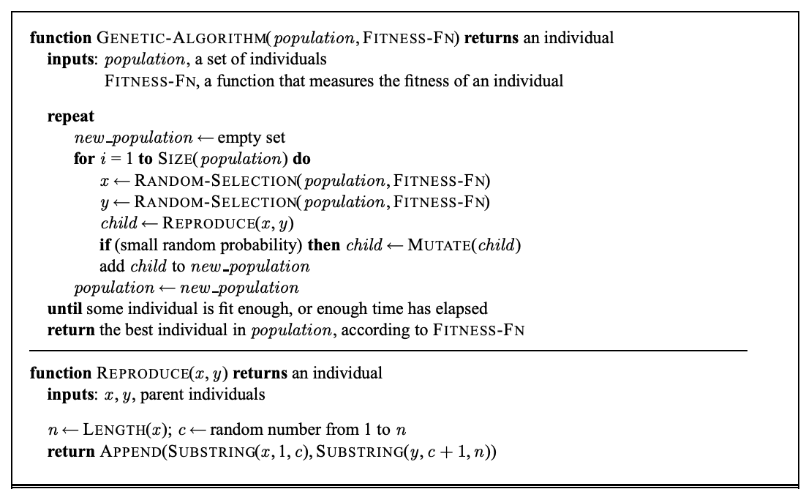

Slide 25
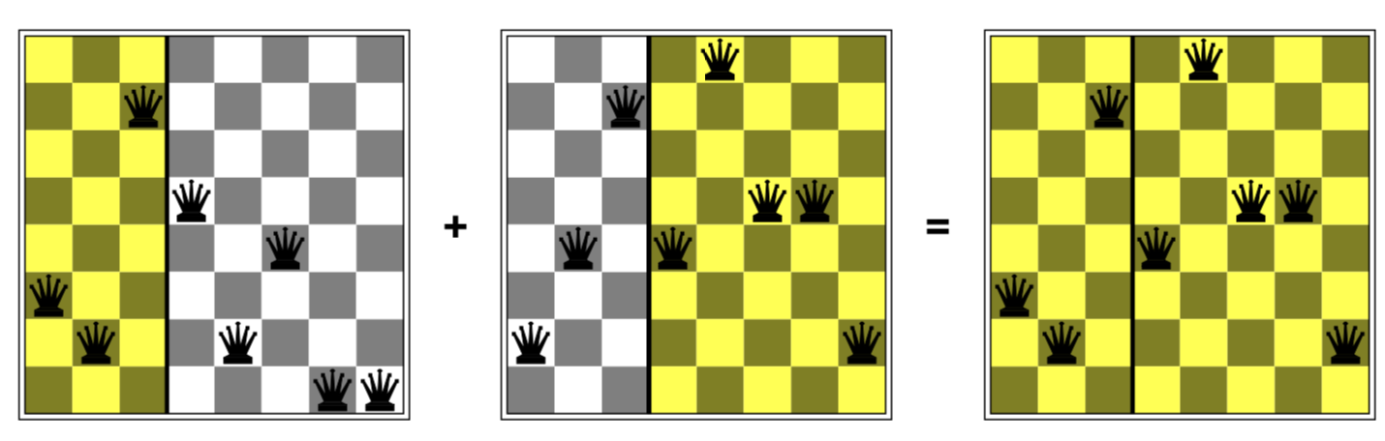
GA examples
GAs require states encoded as strings (GPs use programs)
Crossover helps iff substrings are meaningful components

Slide 26


GA - Neural net optimization, flappy bird example

Slide 27
Summary
Hill-climbing optimizes the solution to minimize/maximize an objective function
To overcome local minima/maxima, randomness is introduced in Simulated annealing and Genetic algorithms
Local search algorithms can be used in many optimization/search problems

Slide 28
Q&A

